Slide 1

SQL CHALLENGE 6
Marketing Analysis

Slide 2
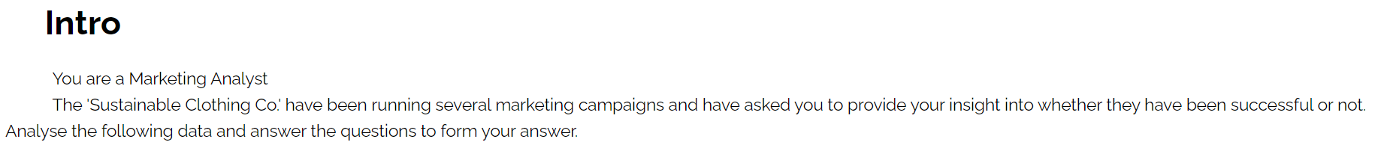

Slide 3
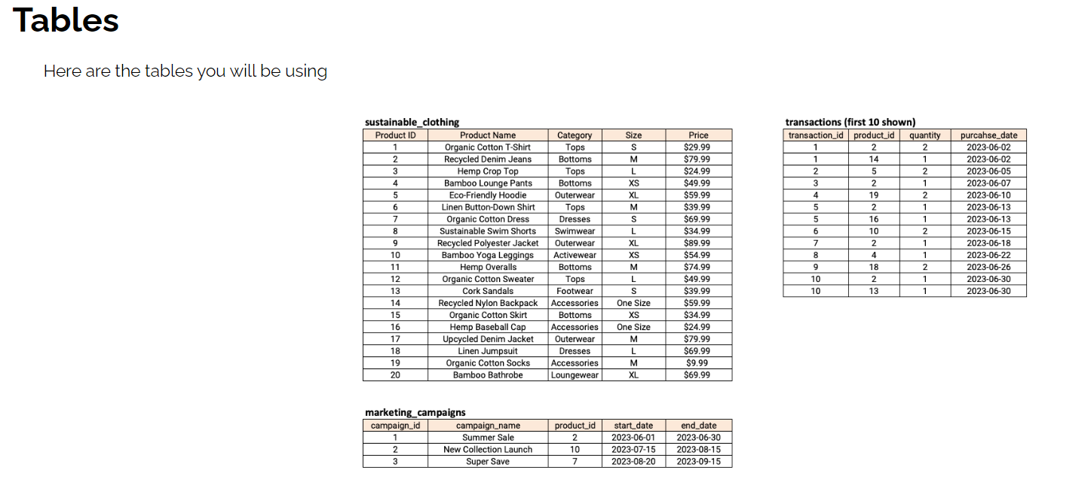

Slide 4
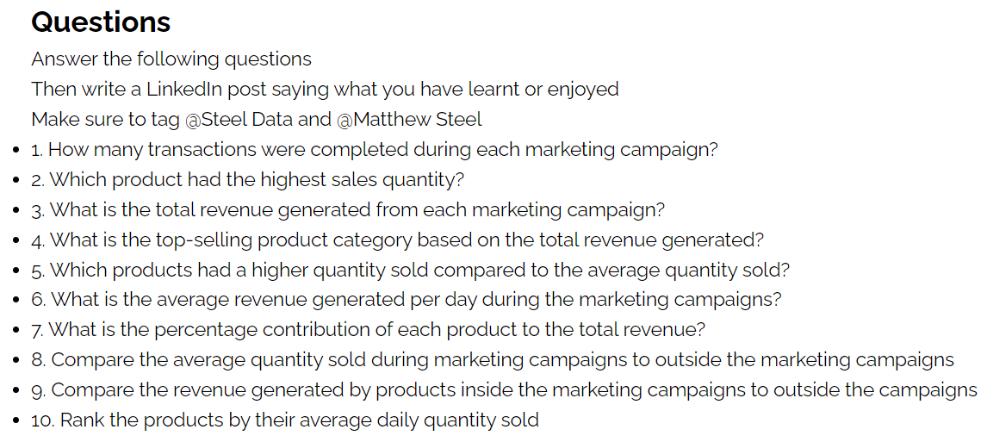

Slide 5
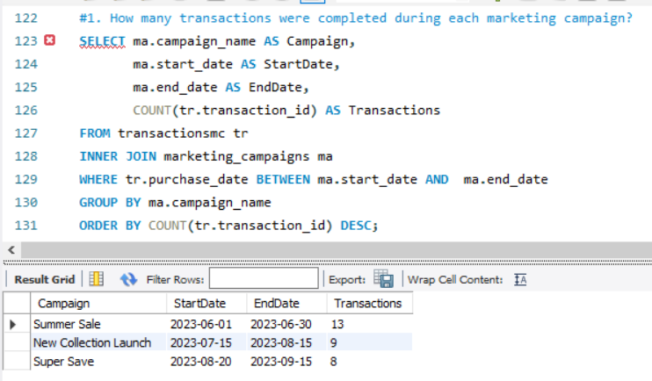

Slide 6
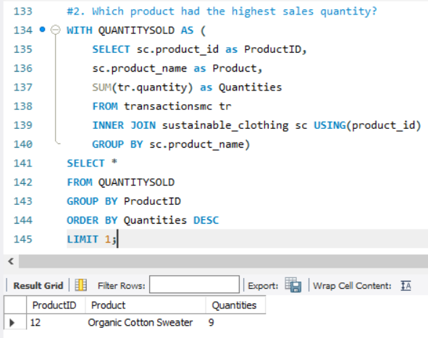

Slide 7
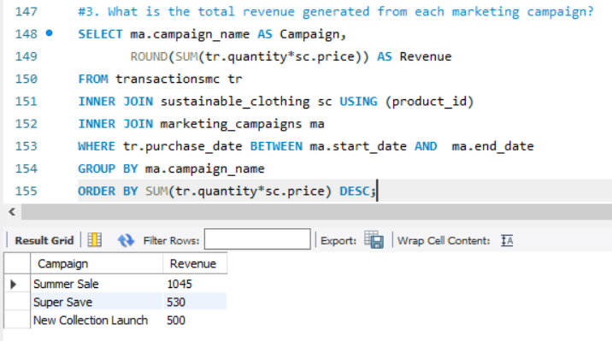

Slide 8
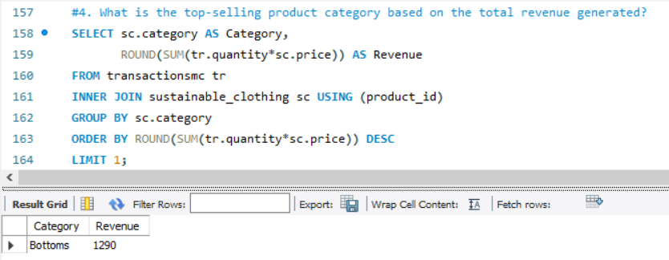

Slide 9
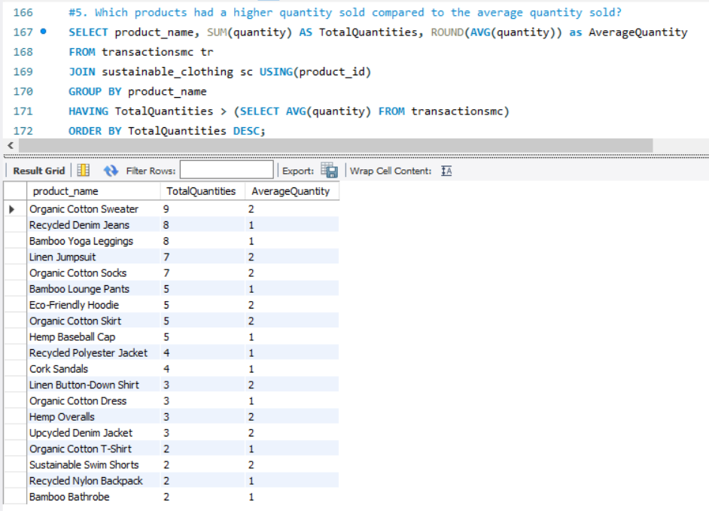

Slide 10
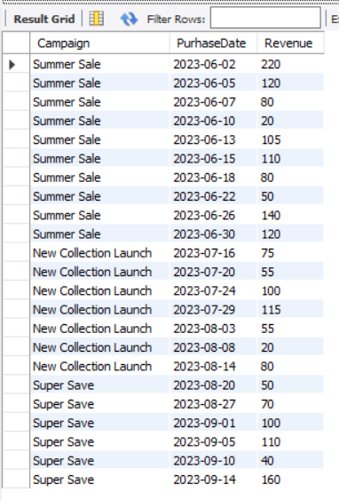
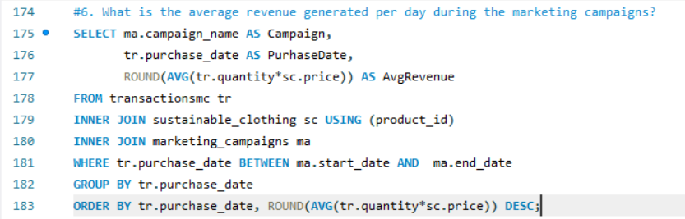

Slide 11
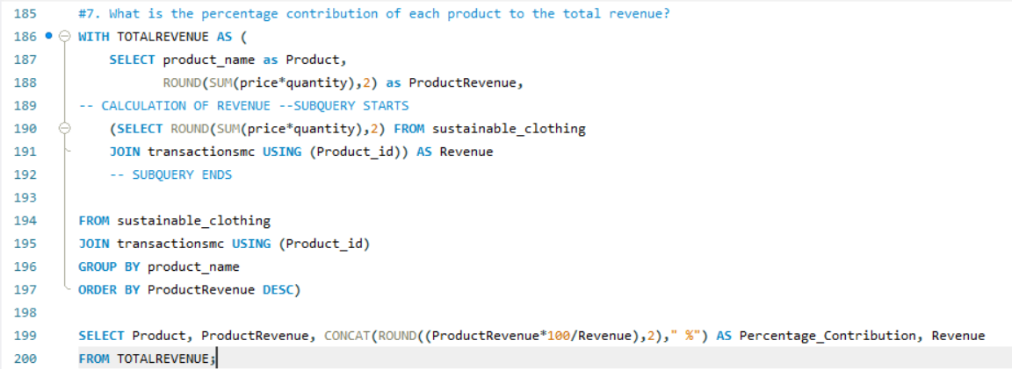
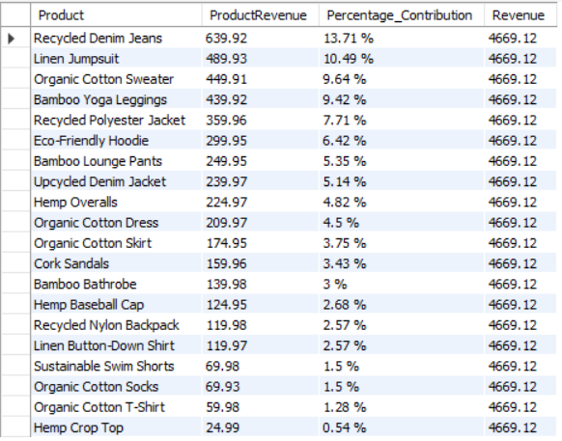

Slide 12
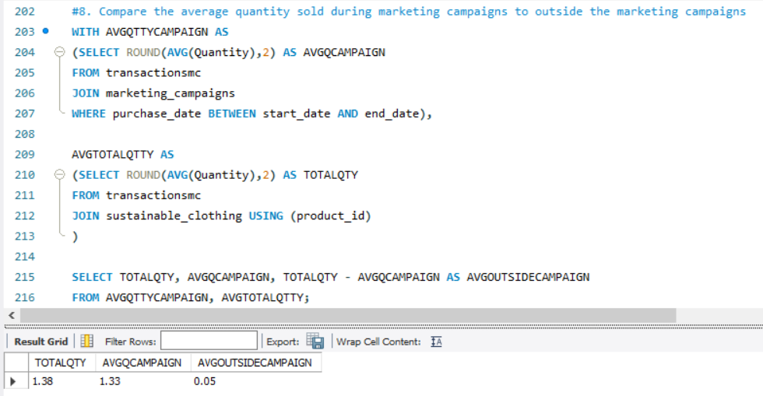

Slide 13
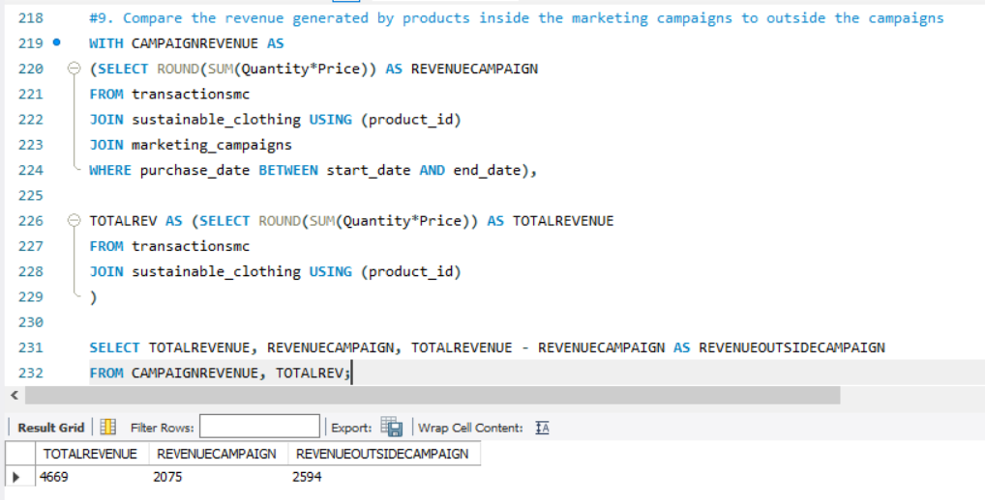

Slide 14
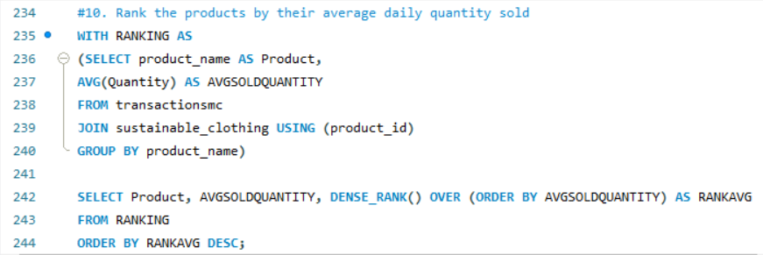
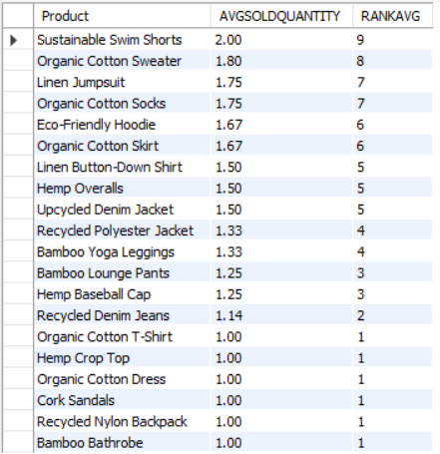

Slide 15
INSIGHTS
Summer sales was the marketing campaign which registered most transactions and the highest revenue out of the three campaigns.
Organic cotton sweater was the most sold product.
Bottoms was the category which recorded the top revenue.
Recycled denim jean, linen jumpsuit and organic cotton sweater were the top 3 products which had the highest percentage contribution to the total revenue generated.
A higher revenue was obtained outside marketing campaigns.

